Slide 1
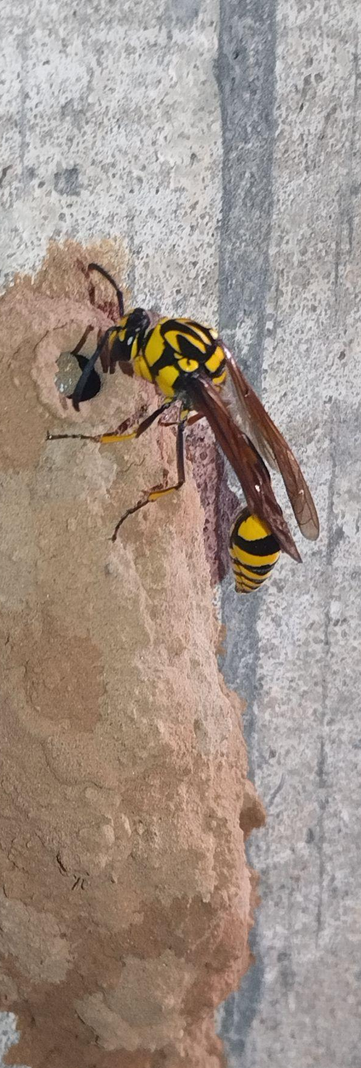
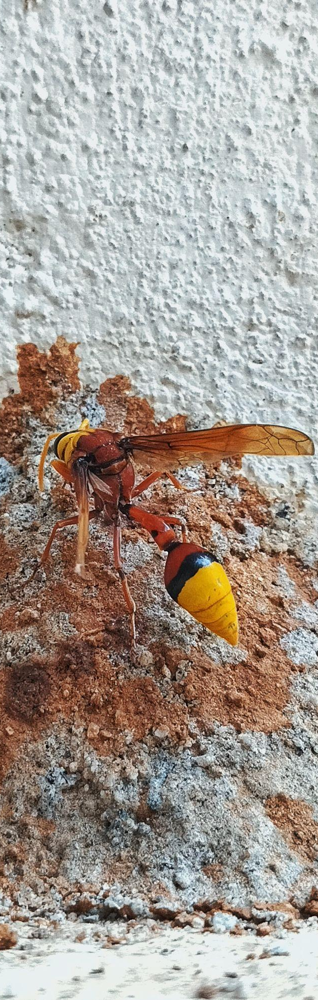
Phylogenetic Tree
MS21078 - Potter Wasp
Outgroups: Apis (Apis dorsata), Crabro (Crabro latipes)
Ingroups (Genus names): Eumenes, Phimenes, Delta, Zeta, Katamenes, Euodynerus, Ancistrocerus, Parancistrocerus
Delta sp.
Phimenes sp.

Slide 2
Workflow
File preparation
Run MrBayes
Visualize
Format and Export
Take the Aligned sequence file containing 2 outgroup sequences and 48 Ingroup sequence (.fas Format)
Convert it in to nexus format (.nex)
Run MrBayes program
Program used is Figtree (v1.4.4)
Format the font, taxa name
Add posterior probability value
Improve readability
Export the file
E. tripunctatus sequence was removed from the Aligned.fas file prior to phylogenetic analysis due to extreme branch length.

Slide 3
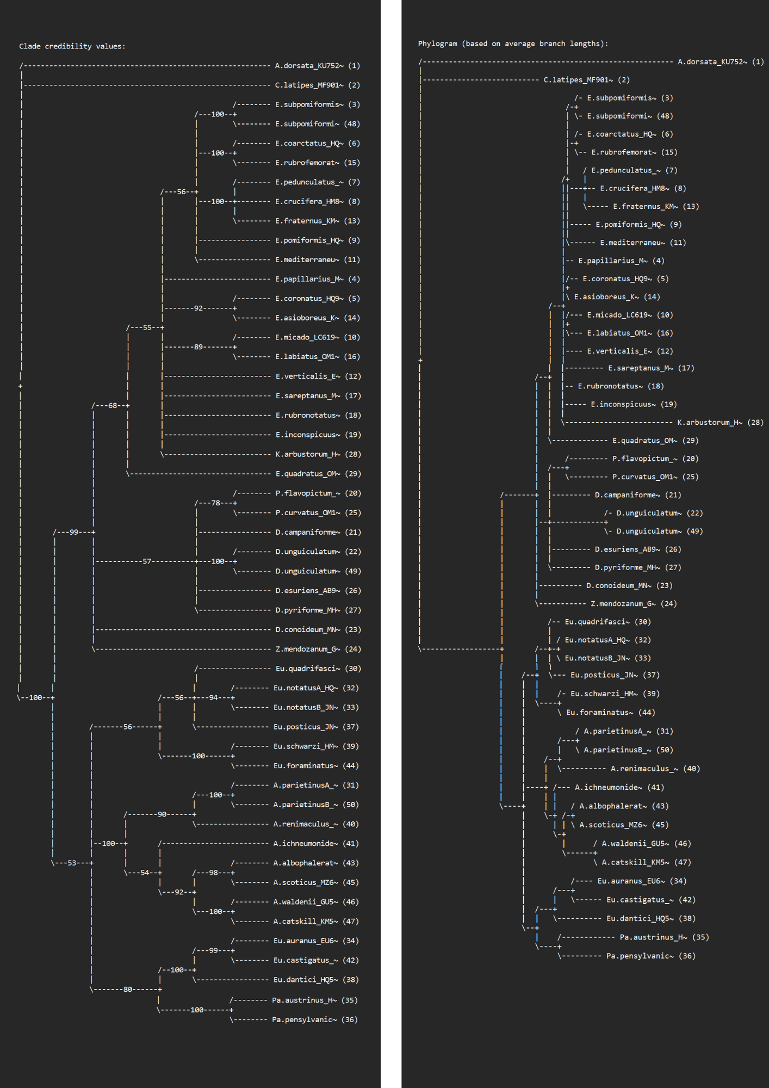
Mrbayes Result
Summary statistics for partitions with frequency >= 0.10 in at least one run:
Average standard deviation of split frequencies = 0.008051
Maximum standard deviation of split frequencies = 0.042304
Average PSRF for parameter values (excluding NA and >10.0) = 1.000
Maximum PSRF for parameter values = 1.004
You can access all the data, files, materials, and Tree results in the following GitHub repository: GitHub Link

Slide 4
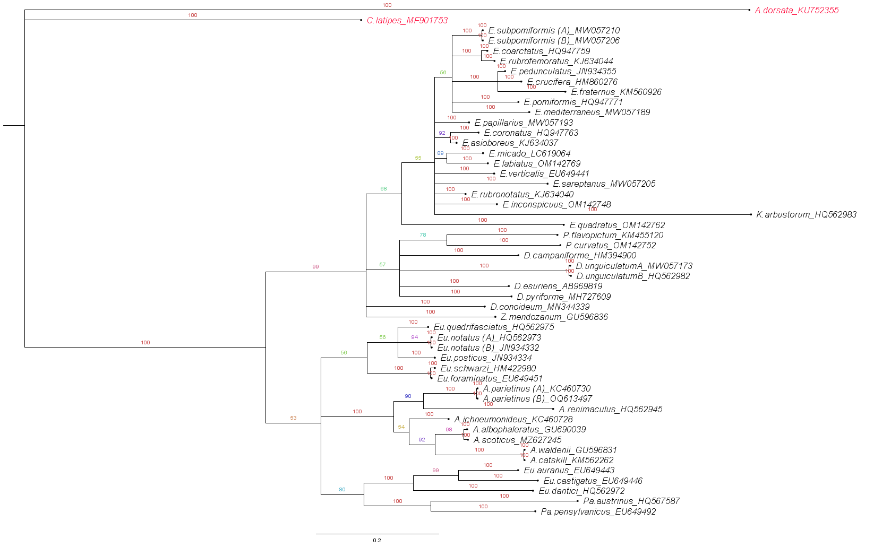
Phylogenetic Tree
MS21078 - Potter Wasp

Slide 5
References
Tree visualization and editing software: Figtree (v1.4.4)
Phylogenetic program for making tree: Mr Bayes
Sequence collected from NCBI
Software used for alignment: NCBI Blast and Bio Edit
Image on title slide: Photograph by the author, Personal collection, Year: 2023, Location: IISc Bangalore

